Slide 1
Module I
Introduction to Soft Computing Artificial
neural networks

Slide 2
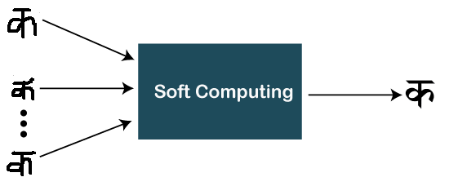
Introduction to soft computing
Soft Computing is the fusion of methodologies designed to model and enable solutions to real world problems, which are not modeled or too difficult to model mathematically. the remarkable ability of the human mind to reason and learn in a environment of uncertainty and imprecision”.
Soft computing is the reverse of hard (conventional) computing. It refers to a group of computational techniques that are based on artificial intelligence (AI) and natural selection. It provides cost-effective solutions to the complex real-life problems for which hard computing solution does not exist.
Zadeh coined the term of soft computing in 1992. The objective of soft computing is to provide precise approximation and quick solutions for complex real-life problems.

Slide 3
Some characteristics of Soft computing
Soft computing provides an approximate but precise solution for real-life problems.
The algorithms of soft computing are adaptive, so the current process is not affected by any kind of change in the environment.
The concept of soft computing is based on learning from experimental data. It means that soft computing does not require any mathematical model to solve the problem.
Soft computing helps users to solve real-world problems by providing approximate results that conventional and analytical models cannot solve.
It is based on Fuzzy logic, genetic algorithms, machine learning, ANN, and expert systems.

Slide 4
Applications of soft computing
It is widely used in gaming products like Poker and Checker.
In kitchen appliances, such as Microwave and Rice cooker.
In most used home appliances - Washing Machine, Heater, Refrigerator, and AC as well.
Apart from all these usages, it is also used in Robotics work (Emotional per Robot form).
Image processing and Data compression are also popular applications of soft computing.
Used for handwriting recognition.
As we already said that, soft computing provides the solution to real-time problems and here you can see that. Besides these applications, there are many other applications of soft computing.

Slide 5
Need of soft computing
Sometimes, conventional computing or analytical models does not provide a solution to some real-world problems. In that case, we require other technique like soft computing to obtain an approximate solution.
Hard computing is used for solving mathematical problems that need a precise answer. It fails to provide solutions for some real-life problems. Thereby for real-life problems whose precise solution does not exist, soft computing helps.
When conventional mathematical and analytical models fail, soft computing helps, e.g., You can map even the human mind using soft computing.
Analytical models can be used for solving mathematical problems and valid for ideal cases. But the real-world problems do not have an ideal case; these exist in a non-ideal environment.
Soft computing is not only limited to theory; it also gives insights into real-life problems.
Like all the above reasons, Soft computing helps to map the human mind, which cannot be possible with conventional mathematical and analytical models.

Slide 6
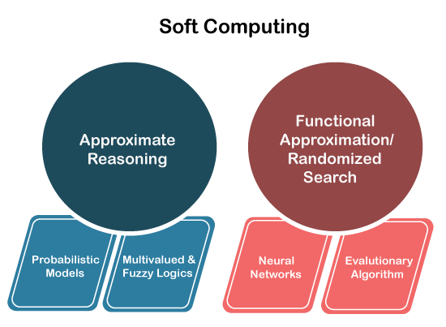
Elements of soft computing
Soft computing is viewed as a foundation component for an emerging field of conceptual intelligence. Fuzzy Logic (FL), Machine Learning (ML), Neural Network (NN), Probabilistic Reasoning (PR), and Evolutionary Computation (EC) are the supplements of soft computing. Also, these are techniques used by soft computing to resolve any complex problem.
Any problems can be resolved effectively using these components. Following are three types of techniques used by soft computing:
Fuzzy Logic
Artificial Neural Network (ANN)
Genetic Algorithms

Slide 7
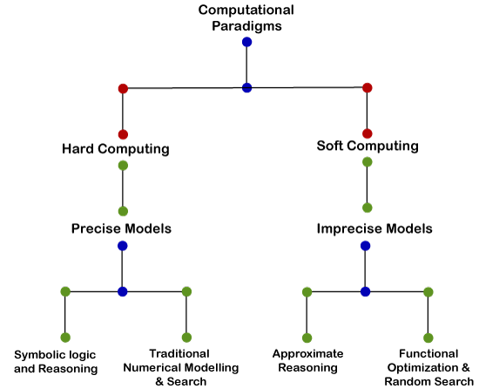
Soft computing vs hard computing
Hard computing uses existing mathematical algorithms to solve certain problems. It provides a precise and exact solution of the problem. Any numerical problem is an example of hard computing.
On the other hand, soft computing is a different approach than hard computing. In soft computing, we compute solutions to the existing complex problems. The result calculated or provided by soft computing are also not precise. They are imprecise and fuzzy in nature.

Slide 8
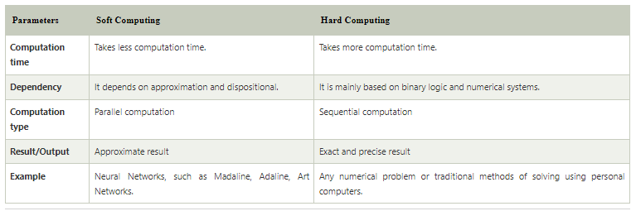

Slide 9
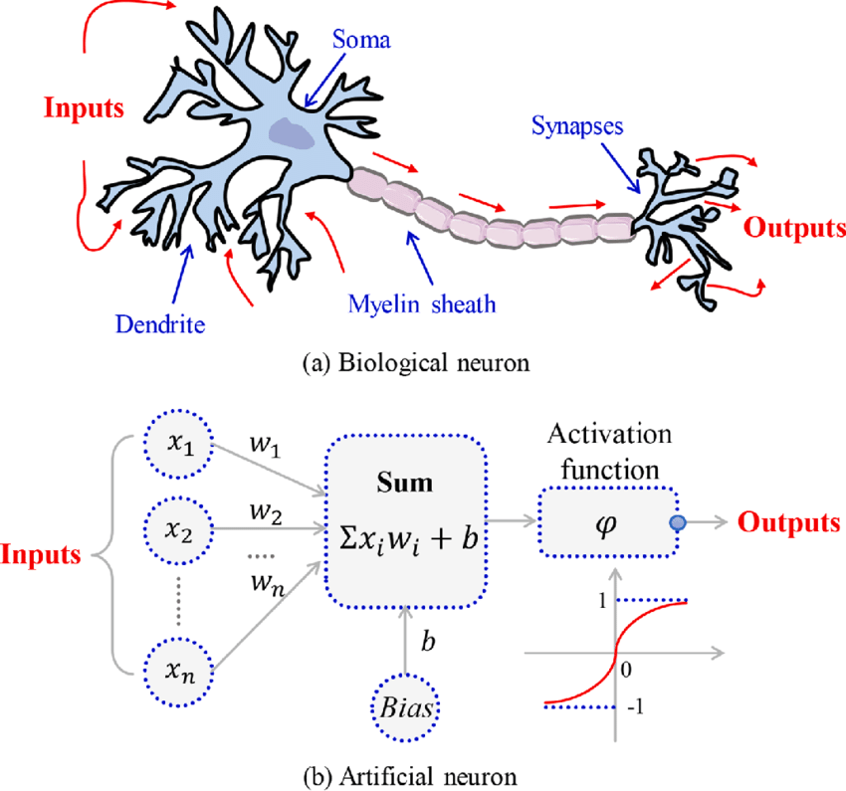
Artificial neurons vs
biological neurons

Slide 10
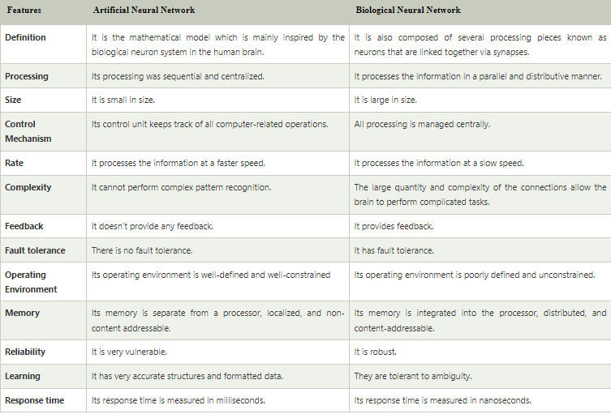

Slide 11
Basic models of artificial neural networks
The models of ANN are specified by the three basic entities namely:
1. The model's synaptic interconnections;
2. The training or learning rules adopted for updating and adjusting the
connection weights;
3. Their activation functions.

Slide 12
The arrangement of neurons to form layers and the connection pattern formed within and between layers is led the network architecture.
There exist five basic types of neuron connection architectures.
They are:
1. single-layer feed-forward network
2. Multilayer feed-forward network
3. Single node with its own feedback
4. single-layer recurrent network
5. Multilayer recurrent network
Basically, neural nets are classified into single-layer or multilayer neural nets. A layer is formed by taking a processing element and
combining it with other processing elements.

Slide 13
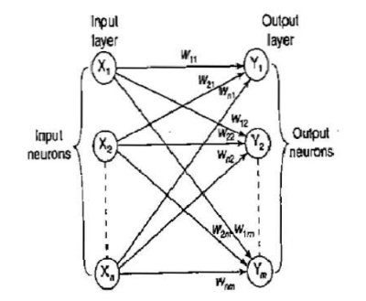
1. single-layer feed-forward network
A layer implies a stage, going stage by stage, i.e., the input stage and the output stage are linked with each other. These linked interconnections lead to the formation of various network architectures.
When a layer of the processing nodes is formed, the inputs can be connected to these nodes with various weights, resulting in a series of outputs, one per node. Thus, a single-layer feed-forward network is formed.

Slide 14
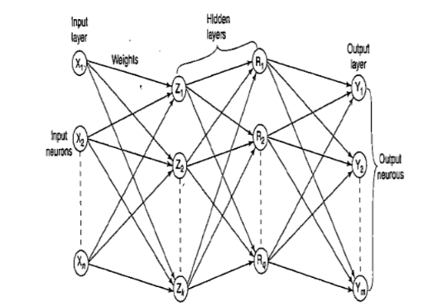
2. Multilayer feed-forward network
A multilayer feed-forward network is formed by the interconnection of several layers. The input layer is that which receives the input and this layer has no function except buffering the input signal.
The output layer generates the output of the network.
Any layer that is formed between e input and output layers is called hidden layer. This hidden layer is internal to the network and has no direct contact with the external environment. There may be zero to several hidden layers in an ANN.
More the number of the hidden layers, more is the complexity of the network.

Slide 15
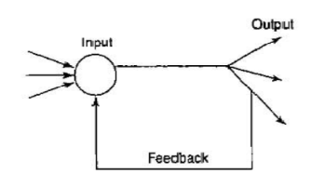
3. Single node with its own feedback
A network is said to be a feed forward network if no neuron in the output layer is an input to a node in the same layer or in the preceding layer.
When outputs can be directed back as inputs to same or preceding layer nodes then it results in the formation of feedback networks.
If the feedback of the output of the processing elements is directed back as input to the processing elements in the same layer then it is called lateral feedback. Recurrent networks are feedback networks with closed loop.
The Figure below shows a simple recurrent neural network having a single neuron with feedback to itself.

Slide 16
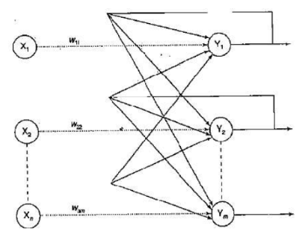
4. single-layer recurrent network
The Figure below shows a single layer network with a feedback connection in which a processing element's output can be directed back to the processing element itself or to the other processing element or to both.

Slide 17
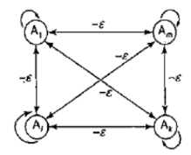
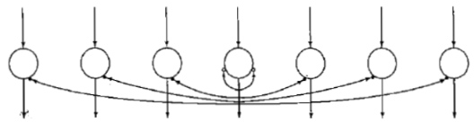
The architecture of a competitive layer is shown in Figure below, the competitive interconnections having fixed weights of -e. This net is called Maxnet.
Lateral inhibition structure:In this structure, each processing neuron receives two different classes of inputs- "excitatory" input from nearby processing elements and "inhibitory" inputs from more distantly located processing elements. This type of interconnection is shown in Figure below:

Slide 18
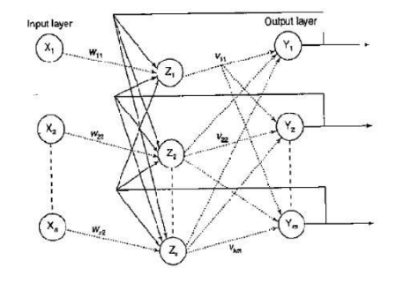
5. Multilayer recurrent network
A processing element output can be directed back to the nodes in a preceding layer, forming a multilayer recurrent network. In these networks, a processing element output can be directed back to the processing element itself and to other processing elements in the same layer.

Slide 19
Learning
There are two kinds of learning in ANNs:
1. Parameter learning: It updates the connecting weights in a neural
net.
2. Structure learning: It focuses on the change in network structure
Apart from these two categories of learning, the learning in an ANN can be generally classified into three categories as:
Supervised learning
Unsupervised learning
Reinforcement learning

Slide 20
1) Supervised Learning
each input vector requires a corresponding target vector, which represents the desired output.
The input vector along with the target vector is called training pair.
The network here is informed precisely about what should be emitted as output.
The block diagram below depicts the working of a supervised learning network.
During training, the input vector is presented to the network, which results in an output vector. This output vector is the actual output vector.
Then the actual output vector is compared with the desired (target) output vector.
If there exists a difference between the two output vectors then an error signal is generated by the network.
This error signal is used for adjustment of weights until the actual output matches the desired output.
In this type of training, a supervisor is required for error minimization.

Slide 21
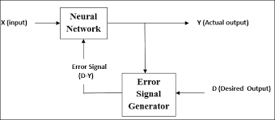

Slide 22
2) Unsupervised Learning
The input vectors of similar type are grouped without the use of training data to specify how a member of each group looks or to which group a number belongs.
In the training process, the network receives the input patterns and organizes these patterns to form clusters.
When a new input pattern is applied, the neural network gives an output response indicating the class to which the input pattern belongs.
If for an input, a pattern class cannot be found then a new class is generated.
there is no feedback from the environment to inform what the outputs should be or whether the outputs are correct.
In this case, the network must itself discover patterns, regularities,features or categories from the input data and relations for the input data over the output.
While discovering all these features, the network undergoes change in its parameters. This process is called self organizing in which exact clusters will be formed by discovering similarities and dissimilarities among the objects.

Slide 23


Slide 24
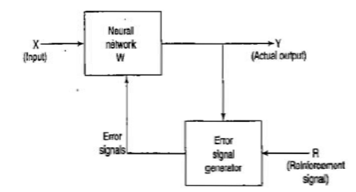
3) Reinforcement Learning

Slide 25
This learning process is similar to supervised learning.
In the case of supervised learning, the correct target output values are known for each input pattern.
But, in some cases, less information might be available.
The reinforcement learning is a form of supervised learning because the network receives some feedback from its environment.
The reinforcement learning is also called learning with a critic as opposed to learning with a teacher, which indicates supervised learning.

Slide 26
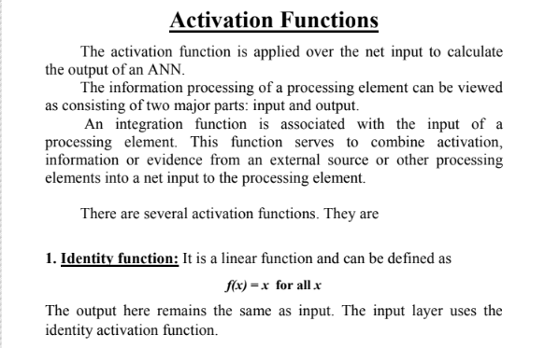

Slide 27
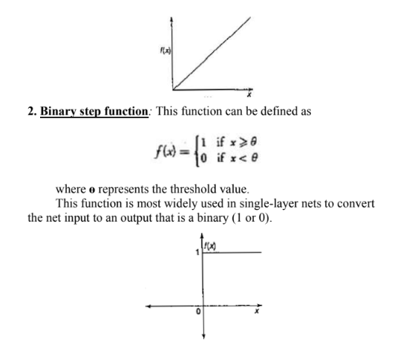

Slide 28
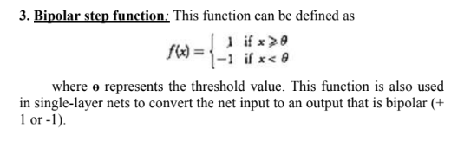
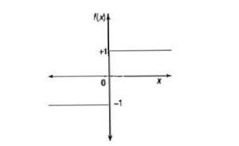

Slide 29
4. Sigmoidal functions:
The sigmoidal functions are widely used in back-propagation nets because of the relationship between the value of the functions at a point and the value of the derivative at that point which reduces the computational burden during training.
Sigmoidal functions are of two types: -
Binary sigmoid function
Bipolar sigmoid function:

Slide 30
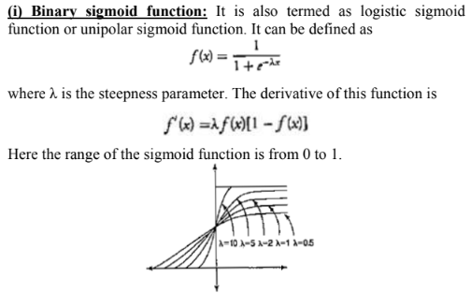

Slide 31

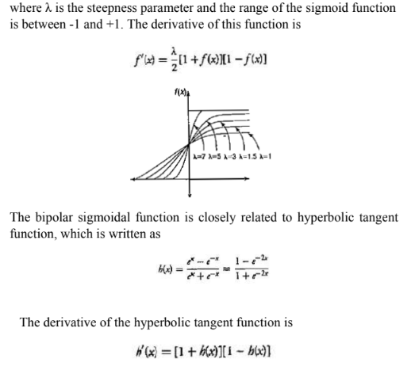

Slide 32
